Slide 1

EchoFrames
Echoframes is an innovative photography project dedicated to visualizing environmental sustainability through compelling visual storytelling.

Slide 2
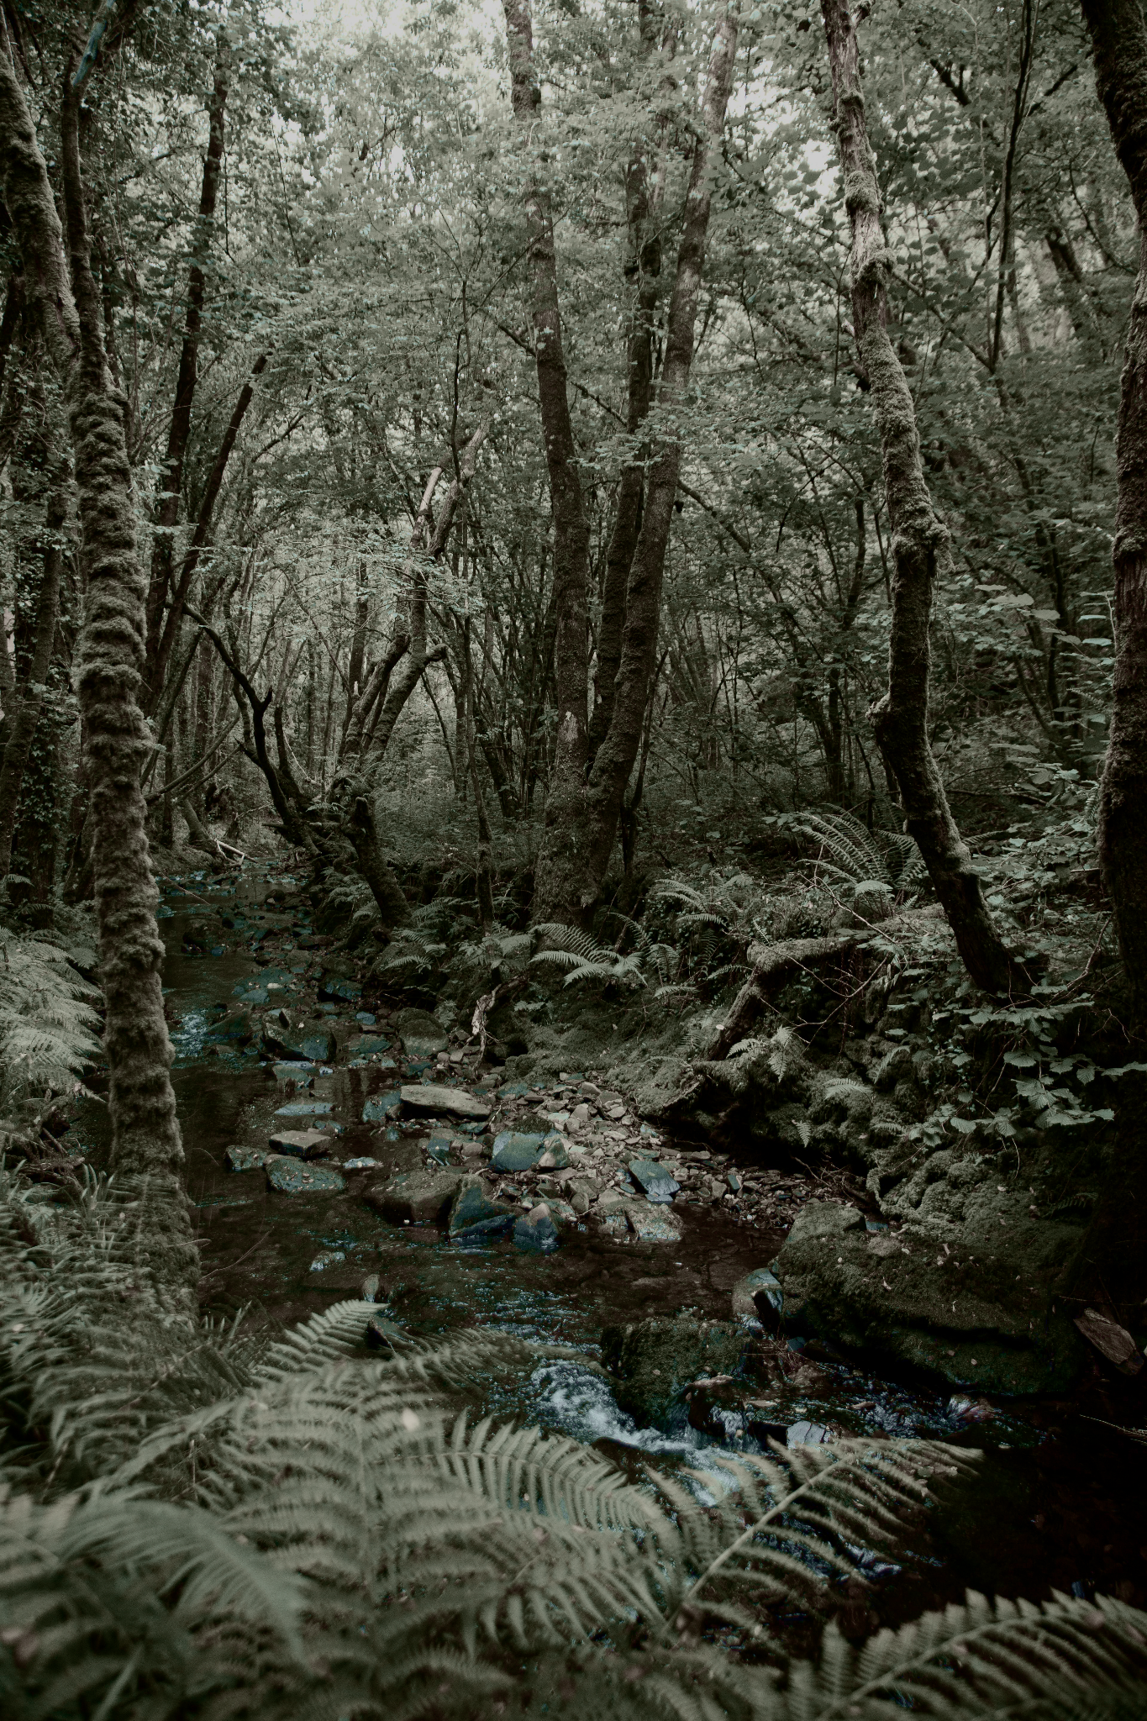
Problem Statement
In an era of digital creativity, photographers and visual artists lack a comprehensive platform that allows them to not only showcase their own diverse photographic genres—including Human Photography, Wildlife, and Nature—but also provide a collaborative space where other creators can upload and share their work. The challenge is developing a dynamic, user-friendly website that serves as both a personal portfolio and a community-driven visual storytelling platform, enabling seamless exploration, interaction, and shared creative expression across multiple photography genres

Slide 3
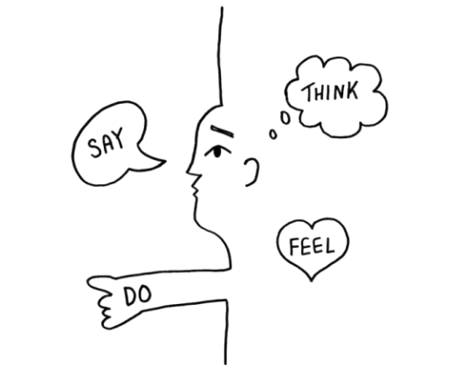
Understanding Users : Empathy Mapping
"I want a sleek, professional website to showcase my work."
"My photos should speak for themselves without too much clutter."
"I want easy navigation for my visitors."
"Is my work good enough to attract clients?"
"How will clients contact me through the website?"
Excited about displaying their best work. Nervous about their site’s drst impression. Anxious about missing out on potential clients.
Browse competitor websites for inspiration.
Constantly tweak and upload images. Share their website on social media or professional platforms.
Respond to inquiries via email or forms.

Slide 4
Defining Key Goals
User Engagement
Offer a seemless browsing and uploading experience to enhance user satisfaction anf interaction with the platform.
Inspiring Design
Creates visually stunning pages that resonate with users ensuring aesthetic appeal and functionality enhance the overall user experience.
Community Building
Facilitate connections between photography enthusiasts, encouraging collaborations, sharing and support within the community.

Slide 5
Prototyping the Website
Gallery
Create Account
This section displays a grid of four icons representing different categories of photos - Nature, Animals, Paradise, and Humans. These icons likely serve as entry points to browse and view photos within those categories.
A section for users to sign up and create an account on the website, including fields for name, email, password, and gender.
User Features
About Us
The prototype suggests that users will be able to showcase their own photography skills, share their creativity with the world, and browse through others' projects to find inspiration.
This section provides an overview of the EchoFrames project, emphasizing their mission to capture the beauty of life through photography and create a platform for visual storytelling and environmental advocacy.

Slide 6
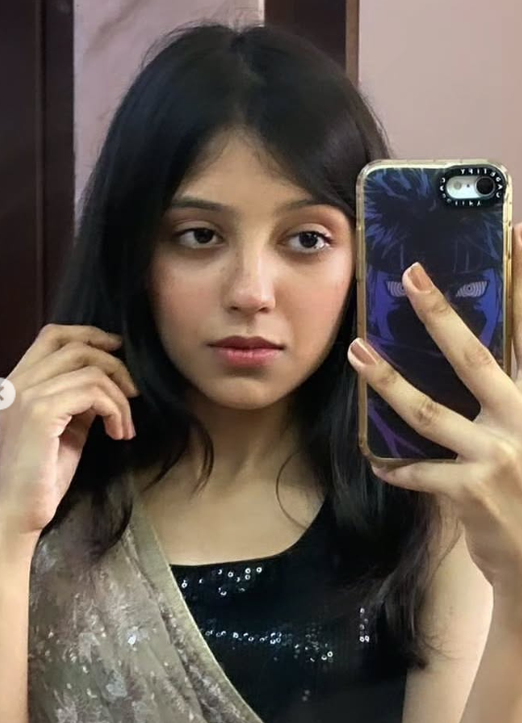
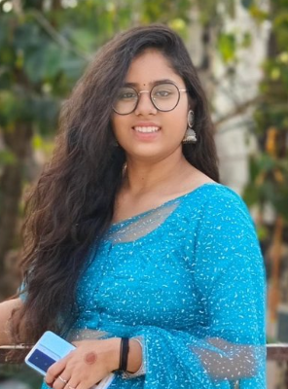
Personas
Shubhangi- Student
Anahita- Student
Recommended: Stylized illustration representing Emma in her work environment
Age: 18
Reduce personal carbon footprint
Learn about sustainable living
Inspire others through visual storytelling
Challenges:
Limited time for extensive research
Overwhelmed by complex environmental information
Seeking actionable, inspiring content
Recommended: Illustration of Michael in a classroom setting with environmental graphics
Age: 19
Create engaging environmental education materials
Connect students with real-world conservation efforts
Visualize environmental impact
Challenges:
Finding compelling visual resources
Making complex environmental concepts accessible
Motivating students to take action

Slide 7
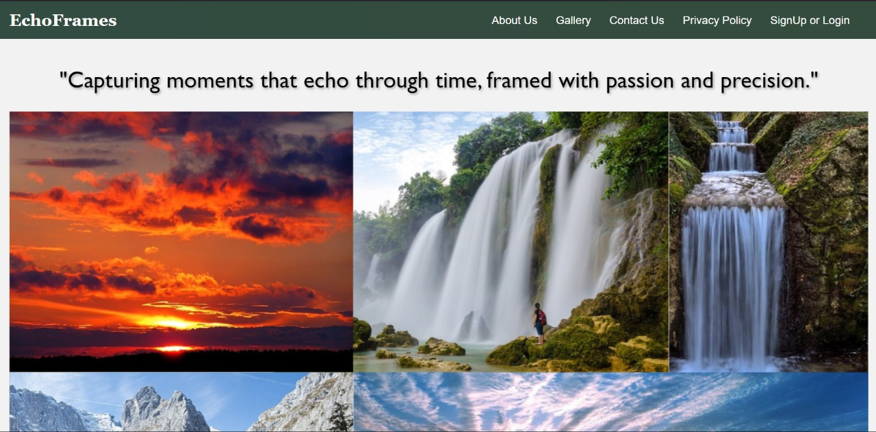
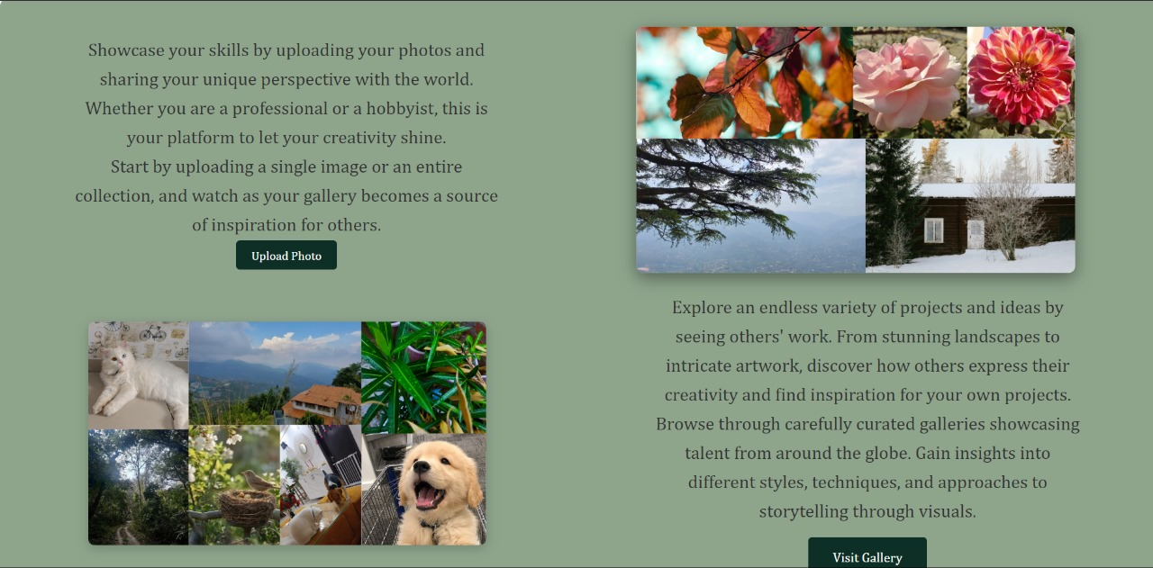
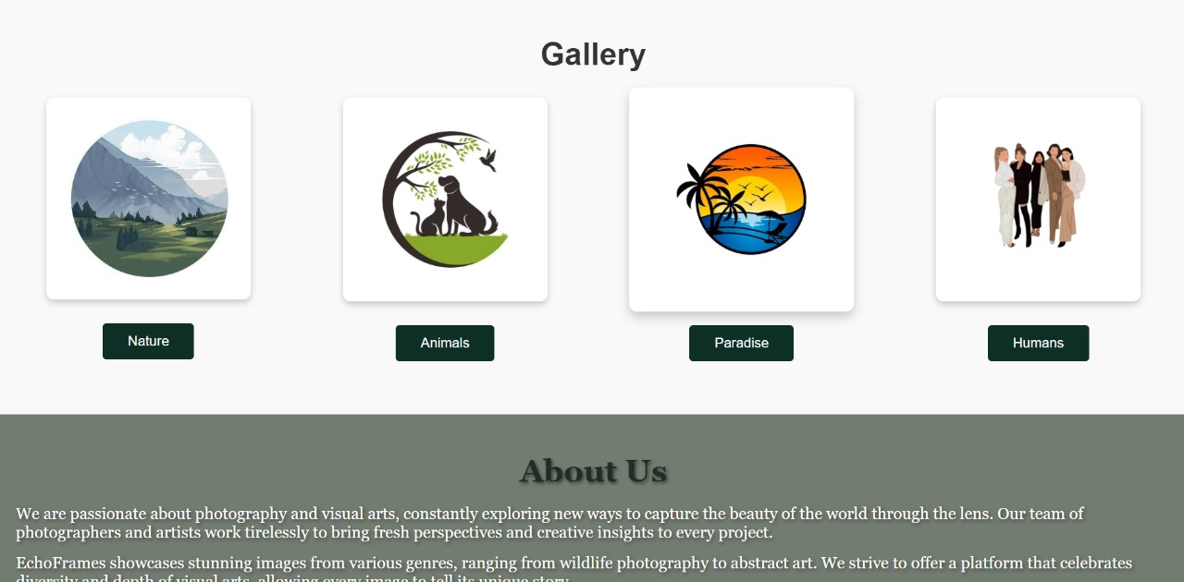
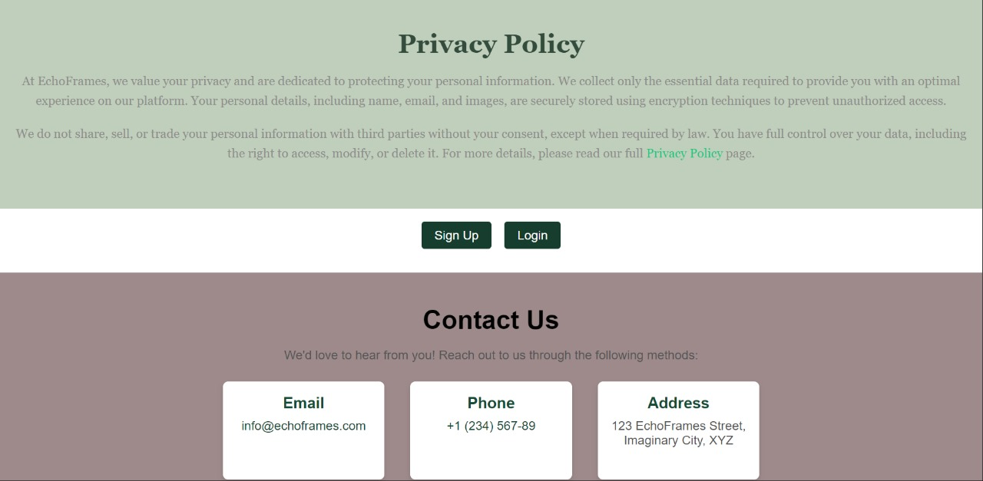
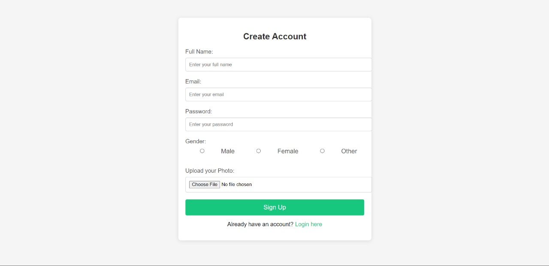
Photo showcase

Slide 8
Photo showcase

Slide 9
Photo showcase

Slide 10
Photo showcase

Slide 11
Photo showcase

Slide 12
Design Process Insights
Intitial Planning
User Flow
UI/UX Design
Defined project goals and features, establishing a clear direction for the design process.
Focused on simplicity, vibrancy, and smooth transitions to engage users effectively.
Designed a seamless journey from homepage to galleries, optimizing navigation and accessibility.
WireFraming
Responsive Design
Created layout drafts to facilitate easy navigation and enhance user experience.
Ensured compatibility across devices, providing a seamless experience on desktops, tablets, and smartphones.

Slide 13




TOOLS AND TECHNOLOGIES USED
HTML5
CSS3
Provides the fundamental structures of the website, including essential elements like headers, footers and sections.
Enhances the visual appeal through styling and animations. Utilizes Flexbox for effective layout management and media queries for mobile responsiveness.
Images
External Links
Utilizes high-quality visuals sourced from various photography genres to create an appealing and immersive user experience.
Facilitates navigation to genre-specific gallery pages, enriching user interaction and accessibility to content.

Slide 14
CHALLENGES AND SOLUTIONS
01
02
03
04
05
06
Responsive Design
Slideshow Transtions
User-Friendly Gallery
CSS Media Queries
CSS Animations
Categorized Galleries

Slide 15
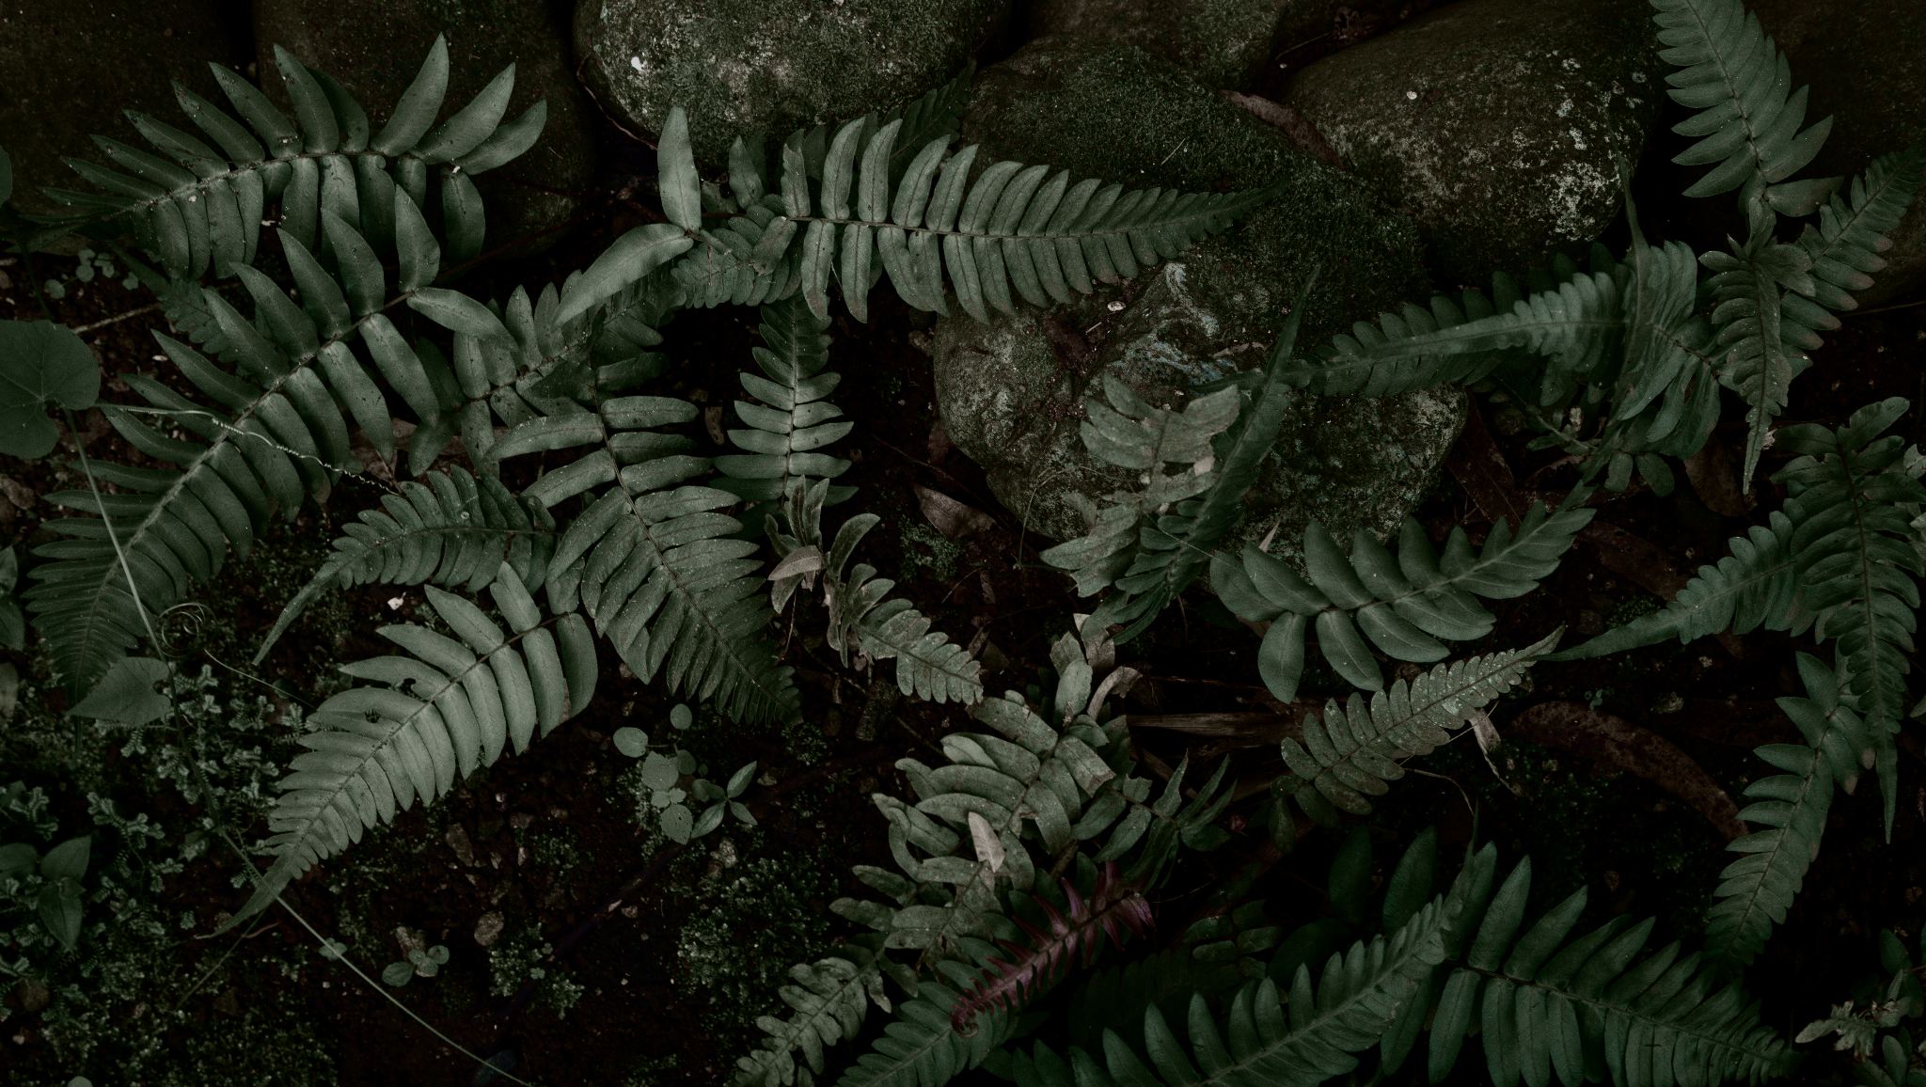
"Creativity is the key to unlocking your true potential"

